Slide 1




DataWare
Data analytics solutions
Climate Change Belief Analysis 2022
#Non-Believer
#Believer

Slide 2






MEET THE TEAM
Jennifer Mukami
Project Manager
Falalu Barde
UI/UX Designer
Israel Ezeama
AI/ ML Developer
Edward Ogbei
QA Analyst/ Tester
Gabriel Asiegbu
Business Analyst
DataWare
Data analytics solutions
2
https://data-ware.io/

Slide 3






CONTENTS
Introduction
Exploratory Data Analysis
Data Processing
Modelling
Conclusion
Trident AI Application Review
DataWare
Data analytics solutions
3
https://data-ware.io/

Slide 4
INTRODUCTION
Overview
Many companies would like to determine how people perceive climate change and whether or not they believe it is a real threat.
Problem Statement
?
We are looking to Empower the marketing department of your Company to maximize profitability based on customer’s preference.
We are also going reduce the wastages incurred by the product team by mass producing products that customer’s don’t need.
Data Set
The collection of this data was funded by a Canada Foundation for Innovation JELF Grant to Chris Bauch, University of Waterloo.
DataWare
Data analytics solutions
4
https://data-ware.io/

Slide 5






INTRODUCTION
Class Description and Tools
1: Pro
- 1: Anti
The tweet does not believe in man-made climate change
The tweet supports the belief of man-made climate change
0: Neutral
The tweet neither supports nor refutes the belief of man-made climate
2: News
The tweet links to factual news about climate change
DataWare
Data analytics solutions
5
https://data-ware.io/

Slide 6
EXPLORATORY DATA ANALYSIS
Tweets & Sentiments
Number of observations
15,819
Tweet ID
No Missing Data
DataWare
Data analytics solutions
6
https://data-ware.io/

Slide 7
EXPLORATORY DATA ANALYSIS
DataWare
Data analytics solutions
7
https://data-ware.io/

Slide 8
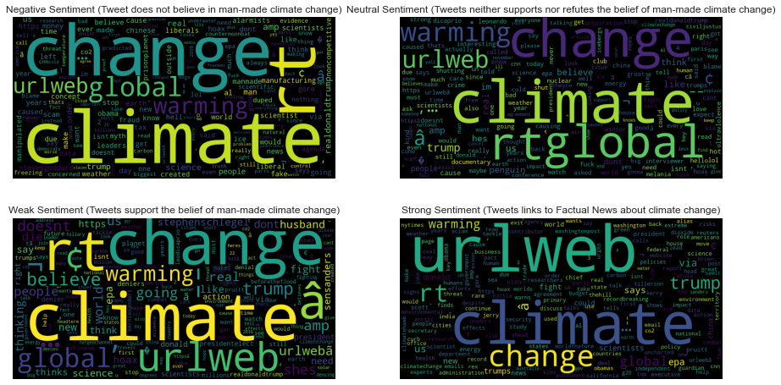

EXPLORATORY DATA ANALYSIS
Word Cloud
Negative Sentiment
Neutral Sentiment
Weak Sentiment
Strong Sentiment
DataWare
Data analytics solutions
8
https://data-ware.io/

Slide 9

DATA PROCESSING
Text Preprocessing
Feature Extraction
Line breaks
URL’s
Numbers
Capital letters
Punctuation
Maximum word frequency
Minimum word frequency
ngram range
Stop words
CountVectorizer
TfidVectorizer
DataWare
Data analytics solutions
9
https://data-ware.io/

Slide 10

MODELLING
Models
01
01
Multinomial Naive Bayes - Base Model
03
02
02
Complement Naive Bayes
Logistic Regression
04
Linear Support Vector Classifier
DataWare
Data analytics solutions
10
https://data-ware.io/

Slide 11
MODEL PERFORMANCE
Before Class Balancing
Model Testing Scores
DataWare
Data analytics solutions
11
https://data-ware.io/

Slide 12
MODEL PERFORMANCE
After Class Balancing Using Smote + ENN
Model Testing Scores
DataWare
Data analytics solutions
12
https://data-ware.io/

Slide 13


BEST MODEL
Best Model Resolution
Logistic
Regression
96%
F1-Score
75.4%
Accuracy
DataWare
Data analytics solutions
13
https://data-ware.io/

Slide 14
CONCLUSION
Conclusion
In conclusion, we can thus infer that Logistics Regression classifier performed best both in the training and validation phase with an accuracy score.
Recommendation
The marketing team(s) for Eco-Friendly Companies can move into integrating this model to their focused market domain, gain insight on market behavior, maximise productivity, driving profitability by knowledge of the demand & Supply on her goods & Services.
Click here for a demonstration
DataWare
Data analytics solutions
14
https://data-ware.io/

Slide 15




TRIDENT APP REVIEW
www.data-ware.io
hello@data-ware.io
http://Streamlit page (hyper link)
Thank you!
Questions?
DataWare
Data analytics solutions
15
https://data-ware.io/

